Slide 1




Object Oriented Design and Programming (01AI0403)
Unit – 2
Programming Basics

Slide 2



OUTLINE
Directives
Output using cout
Input with cin
Type bool
The setw
Manipulator
Type conversions

Slide 3
Directives
All the statements starting with the # (hash) symbol are known as preprocessor directives in C++.
To perform certain tasks, the directives instruct the preprocessor to perform certain tasks to improve the program’s performance/capabilities.
Every directive is a one-line long command which contains the following:
All the preprocessor directives in C++ start with the # (hash) symbol).
A pre-processor instruction after the # (hash) symbol like #include, #define, #ifdef, #elif, #error, #pragma etc.
Example:
#include<iostream>, #define PI 3.14, #ifdef PI etc.

Slide 4
C++ iostream
iostream stands for standard input-output stream. #include iostream declares objects that control reading from and writing to the standard streams.
In other words, the iostream library is an object-oriented library that provides input and output functionality using streams.
A stream is a sequence of bytes. You must include iostream header file to input and output from a C++ program.
i.e #include<iostream.h>
#include iostream provides the most used standard input and output streams, cin and cout.

Slide 5
Standard Output Stream -- cout
It is an instance of the ostream class. It produces output on the standard output device, i.e., the display screen.
We need to use the stream insertion operator << to insert data into the standard output stream cout, which has to be displayed on the screen.
Syntax:
cout << variable_name;
OR
cout << variable1 << variable2 << ... ;
(This way of using multiple stream insertion operators with a single cout is called cascading. It helps print multiple variables adjacent to each other on the same line.)

Slide 6
Standard Output Stream -- cout
How to Separate lines in Output?
There are two ways – new line character and endl
Using \n, the new line character
Syntax:
cout << variable1 << '\n' << variable2;
It will print variable1's value and print a new line. Finally, it prints the variable2's value on a new line.

Slide 7
Standard Output Stream -- cout
Using endl, a manipulator
Syntax:
cout << variable1 << endl << variable2;
A manipulator in C++ changes the behavior of an input or output stream.
endl manipulator is a part of the std namespace and can also be used to insert a new line.

Slide 8

Standard Output Stream -- cout
C++ Program using cout
#include<iostream>
using namespace std;
int main()
{
cout<<"Welcome to MU\n";
cout<<"Welcome to\nMU";
cout<<"\nWelcome to"<<endl<<"MU";
return 0;
}

Slide 9
Standard Output Stream -- cin
It is an instance of the istream class.
It reads input from the standard input device, i.e., the keyboard.
We need to use the stream extraction operator >> to extract data entered using the keyboard.
Syntax:
cin >> variable_name;
OR
Cascading can also be done with cin to extract multiple variables.
cin >> variable1 >> variable2 >> ... ;

Slide 10
How to Write Comments in C++?
Comments are used to provide the description about the Logic written in program. Comments are not display on output screen.
When we are used the comments, then that specific part will be ignored by compiler.
In 'C++' language two types of comments are possible
Single line comments
Multiple line comments

Slide 11
How to Write Comments in C++?
Single line comments
Single line comments can be provided by using / /....................
Multiple line comments
Multiple line comments can be provided by using /*......................*/
Note: When we are working with the multiple line comments then nested comments are not possible.

Slide 12
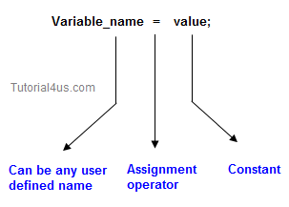
Variable in C++
Variable is an identifier which holds data or another one variable is an identifier whose value can be changed at the execution time of program.
Variable is an identifier which can be used to identify input data in a program.
Syntax
Variable_name = value;

Slide 13
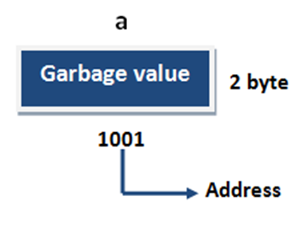
Variable in C++
Variable declarations
This is the process of allocating sufficient memory space for the data in term of variable.
Syntax
datatype variable_name;
Example
int a;
float b;
string name;
If no input values are assigned by the user than system will gives a default value called garbage value.
4 byte

Slide 14
Variable in C++
Garbage value
Garbage value can be any value given by system and that is no way related to correct programs. It is a disadvantage and it can overcome using variable initialization.
Variable initialization
It is the process of allocating sufficient memory space with user defined values.
Syntax
datatype variable_name=value;
Example
int b = 30;

Slide 15
Variable Declaration Rules in C++
Every variable name should start with alphabets or underscore (_).
No spaces are allowed in variable declaration.
Except underscore (_) no special symbol are allowed in the middle of the variable declaration.
Every variable name always should exist in the left hand side of assignment operator.
No keyword should access variable name.

Slide 16
Scope of Variable in C++
In C++ language, a variable can be either of global or local scope.
Global variable
Global variables are defined outside of all the functions, generally on top of the program. The global variables will hold their value throughout the life-time of your program.
Local variable
A local variable is declared within the body of a function or a block. Local variable only use within the function or block where it is declare.

Slide 17
Scope of Variable in C++
Example of Global and Local variable
#include<iostream>
using namespace std;
int a; // global variable
int main()
{
int b; // local variable
a=10, b=20;
cout<<"Value of a: "<<a;
cout<<"Value of b: "<<b;
}
Output
Value of a: 10
Value of b: 20

Slide 18
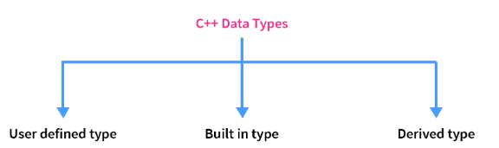
Data types in C++
A data type is the type of data a variable can hold.
For example,
a Boolean variable can have boolean data
a Integer variable can hold integer data.

Slide 19
Data types in C++
1) Built in/Primitive Data Types
These are the data types whose variable can hold maximum one value at a time, in C++ language it can be achieve by int, float, double, char.
These data types are built-in or predefined data types and can be used directly by the user to declare variables. example: int, char , float, bool etc.
Primitive data types available in C++ are:
Integer
Character
Boolean
Floating Point
Double Floating Point
Valueless or Void
Wide Character

Slide 20
Data types in C++
2) Derived Data Types
These data type are derived from primitive or built-in data types. Variables of derived data type allow us to store multiple values of same type in one variable but never allows to store multiple values of different types.
These are the data type whose variable can hold more than one value of similar type.
These can be of four types namely,
Function
Array
Pointer
Reference

Slide 21
Data types in C++
3) User defined(Abstract) data types
User defined data types related variables allows us to store multiple values either of same type or different type or both.
This is a data type whose variable can hold more than one value of dissimilar type, in C++ language.
These data types are defined by user itself. C++ provides the following user-defined datatypes
Class
Structure
Union
Enumeration

Slide 22
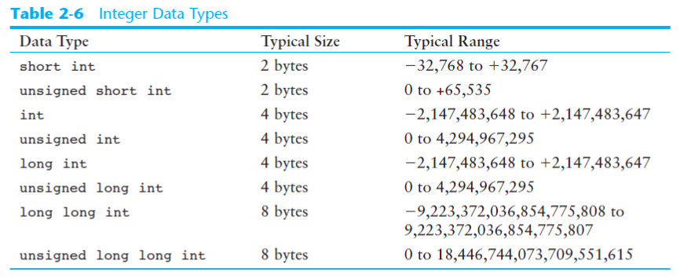
Data types in C++

Slide 23
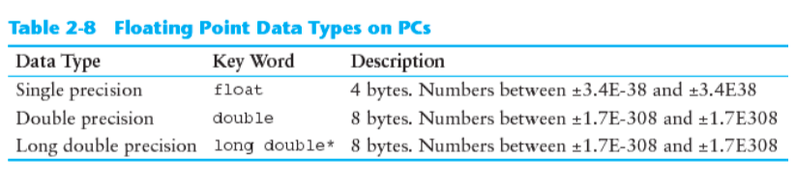
Data types in C++

Slide 24
Enumerated Data type in C++
Enumerations, or enums, are a handy way to create a set of named values that can make your code more readable and maintainable.
Enumeration (Enumerated type) is a user-defined data type that can be assigned some limited values. These values are defined by the programmer at the time of declaring the enumerated type.
Enumerator types of values are also known as enumerators. It is also assigned by zero the same as the array. It can also be used with switch statements.
The enum keyword is used to declare enumerated types after that enumerated type name was written then under curly brackets possible values are defined. After defining Enumerated type variables are created.

Slide 25
Enumerated Data type in C++
Syntax:
enum enumerated-type-name
{
value1, value2, value3…..valueN
};
Enumerators can be created in two types,
It can be declared during declaring enumerated types, just add the name of the variable before the semicolon. or,
Besides this, we can create enumerated type variables as the same as the normal variables.

Slide 26
Enumerated Data type in C++
enumerated-type-name variable-name = value;
Or
enum enumerated-type-name{value1=1, value2, value3};

Slide 27
Enumerated Data type in C++
#include <iostream>
using namespace std;
int main()
{
enum Gender { Male, Female }; // Defining enum Gender
Gender gender = Male; // Creating Gender type variable
switch (gender)
{
case Male:
cout << "Gender is Male";
break;
case Female:
cout << "Gender is Female";
break;
default:
cout << "Value can be Male or Female";
}
return 0;
}
Output:
Gender is Male

Slide 28
Tokens
The smallest individual units in a program are known as tokens.
Keywords
Identifiers
Constants
Strings
Operators

Slide 29
Tokens - Keywords
A reserved word is a word that cannot be used as an identifier, such as the name of a variable, function, or label – it is "reserved from use".
auto | bool | break | case | catch | char | class
const | continue | double | default | delete | else | enum
explicit | friend | float | for | int | long | mutable
new | operator | private | protected | public | register | return
struct | switch | short | sizeof | static | this | typedef
throw | true | try | union | virtual | void | while

Slide 30
Tokens - Identifiers
Identifiers in C++ are short and informative names uniquely identifying C++ variables or function names.
They are user-defined words.
We can't use keywords as identifiers because keywords are pre-defined reserved words.

Slide 31
Tokens
Rules for Identifiers
A valid identifier is a sequence of one or more letters, digits or underscore characters (_).
Neither spaces nor punctuation marks or symbols can be part of an identifier.
Only letters, digits and single underscore characters are valid.
In addition, variable identifiers always have to begin with a letter.
They can also begin with an underline character (_).

Slide 32
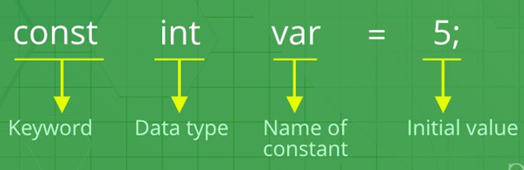
Tokens - Constants
Any value declared as const can not be modified by the program in any way.
It is starting with a const keyword followed by a datatype, an identifier, an assignment operator, and the value.
Constants can be defined locally or globally through this method.
Syntax:
const datatype constantName = value;
Example:

Slide 33
Tokens - Constants
Literals
The value stored in a constant variable is known as a literal. However, constants and literals are often considered synonyms.
Literals can be classified on the basis of datatypes.
Types of literals:
Integer literals
Floating-point literals
Characters literals
Strings literals
Boolean literals
User-defined literals

Slide 34
Tokens - Constants
Integer Literals
When integer values are stored and represented as literal, then such literals are known as integer literals.
Examples:
//defining decimal-literal
const int DECIMAL = 128;
//defining octal-literal
const int OCTAL = 0200;
//defining hex-literal
const int HEX = 0x80;
//defining binary-literal
const int BINARY = 010000000;

Slide 35
Tokens - Constants
Floating-Point Literals
The floating-point literals contain the real numbers.
The real numbers hold an integer part, a real part and a fractional part and an exponential part in it.
A floating-point literal can be stored or represented in two forms: decimal or exponential form.
Example:
const float P= 128.88;

Slide 36
Tokens - Constants
Character Literals
When a single character enclosed by a single quote is stored and represented as a literal, then the literal is known as a character literal.
More than one character should not be stored as a character literal otherwise, it will show a warning along with only the last character of the literal will be displayed.
Example:
const char VARA = 'A'

Slide 37
Tokens - Constants
String Literals
When more than one character is stored in double-quotes and represented as literals. Such a literal is known as a string literal.
It can store all the special as well as escape sequence characters.
Example:
const string A = "is a\ngood\tlearning platform";

Slide 38
Tokens - Constants
Boolean Literals
This literal stores boolean values i.e. True and false.
True is used to represent success
while false represents failure.
True is the same as int 1 while false is similar to int 0.
Example:
const bool VAR1 = true;
const bool VAR2 = false;

Slide 39
Tokens – Strings
A string in C++ is a type of object representing a collection (or sequence) of different characters.
Strings in C++ are a part of the standard string class.
The string class stores the characters of a string as a collection of bytes in contiguous memory locations.
Strings are most commonly used in the programs where we need to work with texts.
C++ supports both strings and character arrays.

Slide 40
Tokens – Strings
Example:
#include <iostream>
using namespace std;
int main()
{
char name[6] = {'h', 'e', 'l', 'l', 'o', '\0’}; // Using char datatype
char str[10]; // Using char datatype
string name1="HELLO"; // Using String datatype
cout<<name;
cout<<name1;
return 0;
}

Slide 41
Tokens – Operators
An operator is a symbol that tells the compiler to perform specific mathematical or logical manipulations.
C++ is rich in built-in operators and provide the following types of operators.
Arithmetic Operators
Relational Operators
Logical Operators
Bitwise Operators
Assignment Operators
Special Operators

Slide 42
Tokens – Operators
Arithmetic Operators
Operator | Name | Description | Example
+ | Addition | Adds together two values | x + y
- | Subtraction | Subtracts one value from another | x - y
* | Multiplication | Multiplies two values | x * y
/ | Division | Divides one value by another | x / y
% | Modulus | Returns the division remainder | x % y
++ | Increment | Increases the value of a variable by 1 | ++x / x++
-- | Decrement | Decreases the value of a variable by 1 | --x / x--

Slide 43
Tokens – Operators
Relational Operators
Operator | Name | Description | Example
== | Equal to | Checks if the values of two operands are equal or not, if yes then condition becomes true. | (A == B) is not true.
!= | Not equal to | Checks if the values of two operands are equal or not, if values are not equal then condition becomes true. | (A != B) is true.
> | Greater than | Checks if the value of left operand is greater than the value of right operand, if yes then condition becomes true. | (A > B) is not true.
< | Less than | Checks if the value of left operand is less than the value of right operand, if yes then condition becomes true. | (A < B) is true.
>= | Greater than equal to | Checks if the value of left operand is greater than or equal to the value of right operand, if yes then condition becomes true. | (A >= B) is not true.
<= | Less than equal to | Checks if the value of left operand is less than or equal to the value of right operand, if yes then condition becomes true. | (A <= B) is true.

Slide 44
Tokens – Operators
Logical Operators
Operator | Name | Description | Example
&& | AND | Called Logical AND operator. If both the operands are non-zero, then condition becomes true. | (A && B) is false.
|| | OR | Called Logical OR Operator. If any of the two operands is non-zero, then condition becomes true. | (A || B) is true.
! | NOT | Called Logical NOT Operator. Use to reverses the logical state of its operand. If a condition is true, then Logical NOT operator will make false. | !(A && B) is true.

Slide 45
Tokens – Operators
Bitwise Operators
Operator | Description | Example
& | Binary AND Operator copies a bit to the result if it exists in both operands. | (A & B) will give 12 which is 0000 1100
| | Binary OR Operator copies a bit if it exists in either operand. | (A | B) will give 61 which is 0011 1101
^ | Binary XOR Operator copies the bit if it is set in one operand but not both. | (A ^ B) will give 49 which is 0011 0001
~ | Binary Ones Complement Operator is unary and has the effect of 'flipping' bits. | (~A ) will give -61 which is 1100 0011 in 2's complement form due to a signed binary number.
<< | Binary Left Shift Operator. The left operands value is moved left by the number of bits specified by the right operand. | A << 2 will give 240 which is 1111 0000
>> | Binary Right Shift Operator. The left operands value is moved right by the number of bits specified by the right operand. | A >> 2 will give 15 which is 0000 1111

Slide 46
Tokens – Operators
Assignment Operators
Operator | Description | Example
= | Simple assignment operator, Assigns values from right side operands to left side operand. | C = A + B will assign value of A + B into C
+= | Add AND assignment operator, It adds right operand to the left operand and assign the result to left operand. | C += A is equivalent to C = C + A
-= | Subtract AND assignment operator, It subtracts right operand from the left operand and assign the result to left operand. | C -= A is equivalent to C = C - A
*= | Multiply AND assignment operator, It multiplies right operand with the left operand and assign the result to left operand. | C *= A is equivalent to C = C * A
/= | Divide AND assignment operator, It divides left operand with the right operand and assign the result to left operand. | C /= A is equivalent to C = C / A
%= | Modulus AND assignment operator, It takes modulus using two operands and assign the result to left operand. | C %= A is equivalent to C = C % A
<<= | Left shift AND assignment operator. | C <<= 2 is same as C = C << 2
>>= | Right shift AND assignment operator. | C >>= 2 is same as C = C >> 2
&= | Bitwise AND assignment operator. | C &= 2 is same as C = C & 2
^= | Bitwise exclusive OR and assignment operator. | C ^= 2 is same as C = C ^ 2
|= | Bitwise inclusive OR and assignment operator. | C |= 2 is same as C = C | 2

Slide 47
Tokens – Operators
Special Operators
S.No | Operator | Description | Example
1 | sizeof | sizeof operator returns the size of a variable. | sizeof(a), where ‘a’ is integer, and will return 4.
2 | ? : | Exp1 ? Exp2 : Exp3; If Condition is true then it returns value of X otherwise returns value of Y. | var = (y < 10) ? 30 : 40;
3 | , | Comma operator causes a sequence of operations to be performed. The value of the entire comma expression is the value of the last expression of the comma-separated list. | var = (count = 19, incr = 10, count+1);
4 | . (dot) and -> (arrow) | Member operators are used to reference individual members of classes, structures, and unions.
5 | Cast | Casting operators convert one data type to another. For example, | int(2.2000) would return 2.
6 | & | Pointer operator & returns the address of a variable. | For example &a; will give actual address of the variable.
7 | * | Pointer operator * is pointer to a variable. | For example *var; will pointer to a variable var.

Slide 48
Some C++ Operators
New operators (All C operators are valid in C++)
<< Insertion Operator
>> Extraction Operator
: : Scope Resolution Operator
: : * Pointer-to-member declaration
->* Pointer-to-member Operator
.* Pointer-to-member Operator
delete Memory Release Operator
endl Line Feed Operator
new Memory Allocation Operator
setw Field Width Operator

Slide 49
Memory management operators (new(), delete())
C++ allows us to allocate the memory of a variable or an array in run time. This is known as dynamic memory allocation.
In other programming languages such as Java and Python, the compiler automatically manages the memories allocated to variables. But this is not the case in C++.
In C++, we need to deallocate the dynamically allocated memory manually after we have no use for the variable.
We can allocate and then deallocate memory dynamically using the new and delete operators respectively.

Slide 50
Memory management operators (new(), delete())
C++ New Operator
The new operator allocates memory to a variable. For example,
// declare an int pointer
int* pointVar;
// dynamically allocate memory
// using the new keyword
pointVar = new int;
// assign value to allocated memory
*pointVar = 45;

Slide 51
Memory management operators (new(), delete())
Here, we have dynamically allocated memory for an int variable using the new operator.
Notice that we have used the pointer pointVar to allocate the memory dynamically.
This is because the new operator returns the address of the memory location.
In the case of an array, the new operator returns the address of the first element of the array.
From the example above, we can see that the syntax for using the new operator is
pointerVariable = new dataType;

Slide 52
Memory management operators (new(), delete())
C++ delete Operator
🞄Once we no longer need to use a variable that we have declared dynamically, we can deallocate the memory occupied by the variable.
For this, the delete operator is used. It returns the memory to the operating system. This is known as memory deallocation.
The syntax for this operator is,
delete pointerVariable;

Slide 53
Memory management operators (new(), delete())
// declare an int pointer
int* pointVar;
// dynamically allocate memory
// for an int variable
pointVar = new int;
// assign value to the variable memory
*pointVar = 45;
// print the value stored in memory
cout << *pointVar;
// deallocate the memory
delete pointVar;
Here, we have dynamically allocated memory for an int variable using the pointer pointVar.
After printing the contents of pointVar, we deallocated the memory using delete.

Slide 54

Dynamic Memory Allocation in C++
#include <iostream>
using namespace std;
int main()
{
// declare an int pointer
int* pointInt;
// declare a float pointer
float* pointFloat;
// dynamically allocate memory
pointInt = new int;
pointFloat = new float;
// assigning value to the memory
*pointInt = 45;
*pointFloat = 45.45f;
cout << *pointInt << endl;
cout << *pointFloat << endl;
// deallocate the memory
delete pointInt;
delete pointFloat; return 0;
}
Output:

Slide 55
Library Functions
The library contains the function implementation, and by including the header file for the corresponding library, we can use the required function in our program.
The C++ Standard Library provides a rich collection of functions for performing common mathematical calculations, string manipulations, character manipulations, input/output, error checking and many other useful operations.
This makes the programmer's job easier, because these functions provide many of the capabilities programmers need.
The C++ Standard Library functions are provided as part of the C++ programming environment.

Slide 56
Library Functions
C++ Standard Library Header File | Description
< cstdlib > | This library consists of several general-purpose functions like conversion related, sequence generation related, dynamic memory management related, etc.
< ctime > | It contains functions to get and manipulate the date and time.
< iomanip > | This library contains IO manipulators that are used to format the stream of data.
< string > | This library contains the function and classes that are useful to work with the string in C++.
< cstring > | It consists of the string handling functions for c-styled strings.
< climits > | This library defines the constant for the fundamental integral types. We generally use these constants for comparisons.
< vector > < list > < deque > < queue > < stack > < map > < set > < bitset > | These all header files are corresponding to the container of the standard template library of C++. Each container exhibits unique properties and is used to store data. The implementation of the data type is written in the associated library.

Slide 57
Library Functions
C++ Standard Library Header File | Description
< iterator > | It contains classes and functions related to iterators that help us in accessing the data of containers.
< algorithm > | It provides various general purpose algorithms to operate on the containers.
< utility > | This is the normal utility library which provides various functions in unrelated domains.
< functional > | The functionality provided by this library is used by the algorithm library.
< exception > | It contains classes for exception handling and other related functions to assist the error handling.
< iostream > | As the name suggests, this library contains functions and streams for standard input and standard output in C++.
< cassert > | It contains macros and functions that are used in the debugging.

Slide 58
Library Functions
Mathematical Functions
Some of the important mathematical functions in header file <cmath> are
Example:
log 10(x) | Logarithm of number x to the base 10
sqrt(x) | Square root of x
pow(x, y) | x raised to the power y
abs(x) | Absolute value of integer number x
fabs(x) | Absolute value of real number x

Slide 59
Library Functions
Character Functions
All the character functions require <cctype> header file. The following table lists the function.
Example:
Function | Meaning
isalpha(c) | It returns True if C is an uppercase letter and False if c is lowercase.
isdigit(c) | It returns True if c is a digit (0 through 9) otherwise False.
isalnum(c) | It returns True if c is a digit from 0 through 9 or an alphabetic character (either uppercase or lowercase) otherwise False.
islower(c) | It returns True if C is a lowercase letter otherwise False.
isupper(c) | It returns True if C is an uppercase letter otherwise False.
toupper(c) | It converts c to uppercase letter.
tolower(c) | It converts c to lowercase letter.

Slide 60
Directives
Preprocessor Directives
Preprocessor programs provide preprocessor directives that tell the compiler to preprocess the source code before compiling.
All of these preprocessor directives begin with a ‘#’ (hash) symbol.
The ‘#’ symbol indicates that whatever statement starts with a ‘#’ will go to the preprocessor program to get executed.
Examples of some preprocessor directives are:
#include, #define, #ifndef etc.

Slide 61
Directives
There are 2 Main Types of Preprocessor Directives:
Inclusion Directive
Macro Definition Directive
1) Inclusion Directive
This type of preprocessor directive tells the compiler to include a file in the source code program.
There are two types of files that can be included by the user in the program:
- Header files or Standard files
- User-defined files

Slide 62
Directives
Header files or Standard files
These files contain definitions of pre-defined functions like cout, cin, etc. These files must be included to work with these functions.
Different functions are declared in different header files.
Syntax:
#include< file_name >
where file_name is the name of the file to be included. The ‘<‘ and ‘>’ brackets tell the compiler to look for the file in the standard directory.

Slide 63
Directives
User-defined files
When a program becomes very large, it is a good practice to divide it into smaller files and include them whenever needed. These types of files are user-defined files.
Syntax: #include "filename“
2) Macro Definition Directive
Macros are pieces of code in a program that is given some name.
Whenever this name is encountered by the compiler, the compiler replaces the name with the actual piece of code. The ‘#define’ directive is used to define a macro.

Slide 64
Directives
Macro Definition – Example
#include <iostream>
using namespace std;
#define LIMIT 5 // macro definition
int main()
{
for (int i = 0; i < LIMIT; i++)
{
cout << i << "\n";
}
return 0;
}

Slide 65
Decision Making Statement
Decision making statement is depending on the condition block need to be executed or not which is decided by condition.
If the condition is "true" statement block will be executed, if condition is "false" then statement block will not be executed.
In C++ language there are three types of decision making statement.
if
if-else
switch

Slide 66
if Statement
If statement is most basic statement of Decision making statement. It tells to program to execute a certain part of code only if particular condition is true.
Syntax
if(condition)
{
..........
..........
}

Slide 67

if Statement - Example
#include<iostream>
using namespace std;
int main()
{
int time;
cout<<“Enter time:”;
cin>>time;
if(time<12)
{
cout<<"Good morning";
}
return 0;
}

Slide 68
if-else statement
It can be used to execute one block of statement among two blocks.
If the condition is “true”, first block of statements to be executed. Otherwise else block of statements has been executed.
Syntax:
if(condition)
{
........
........
}
else
{
........
........
}

Slide 69

if-else statement – Example
#include<iostream>
using namespace std;
int main()
{
int time;
cout<<"Enter time:";
cin>>time;
if(time<12)
{
cout<<"Good morning";
}
else
{
cout<<"Good afternoon";
}
return 0;
}

Slide 70
if...else...else if statement
The if...else statement is used to execute a block of code among two alternatives.
We need to make a choice between more than two alternatives, we use the if...else if...else statement.
Syntax
if (condition1)
{
// code block 1
}
else if (condition2)
{
// code block 2
}
Else
{
// code block 3
}

Slide 71
if...else...else if statement
#include <iostream>
using namespace std;
int main()
{
int n;
cout << "Enter an integer: ";
cin >> n;
if (n > 0)
{
cout << "You entered a positive integer: " << n;
}
else if (n < 0)
{
cout << "You entered a negative integer: " <<n;
}
else
{
cout << "You entered 0." << endl;
}
return 0;
}
Output:
Enter an integer: 12
You entered a positive integer: 12

Slide 72
Nested if else
We need to use an if statement inside another if statement. This is known as nested if statement.
Think of it as multiple layers of if statements. There is a first, outer if statement, and inside it is another, inner if statement.
Syntax:
if (condition1) // outer if statement
{
// statements
if (condition2) // inner if statement
{
// statements
}
}

Slide 73
Nested if else
#include <iostream>
using namespace std;
int main()
{
int n;
cout << "Enter an integer: ";
cin >> n;
if (n!= 0) // outer if condition
{
if (n > 0) // inner if condition
{
cout << "The number is positive";
}
else // inner else condition
{
cout << "The number is negative";
}
}
else // outer else condition
{
cout << "The number is 0 and it is neither positive nor negative";
}
return 0;
}
Output:
Enter an integer: 0
The number is 0 and it is neither positive nor negative.
This line is always printed.

Slide 74
Switch Statement
A switch statement work with short, char and int primitive data type, it also works with enumerated types and string.
Rules for apply switch
With switch statement use only short, int, char data type.
You can use any number of case statements within a switch.
Value for a case must be same as the variable in switch .
Switch case variables can have only int and char data type.
Limitations of switch
float data type is not allowed.
Logical operators cannot be used with switch statement.

Slide 75
Switch Statement
Syntax
switch(ch)
{
case1:
//statement 1;
break;
case2:
statement 2;
break;
default:
//statement
}

Slide 76
Switch Statement - Example
#include<iostream.h>
using namespace std;
int main()
{
int ch;
cout<<"Enter any number (1 to 7)";
cin>>ch;
switch(ch)
{
case 1:
cout<<"Today is Monday";
break;
case 2:
cout<<"Today is Tuesday";
break;
case 3:
cout<<"Today is Wednesday";
break;
case 4:
cout<<"Today is Thursday";
break;
case 5:
cout<<"Today is Friday";
break;
case 6:
cout<<"Today is Saturday";
break;
case 7:
cout<<"Today is Sunday";
break;
default:
cout<<"Only enter value 1 to 7";
}
return 0;
}
Output
Enter any number (1 to 7): 5
Today is Friday

Slide 77
Control Flow / Looping statements
Loops
Set of instructions given to the compiler to execute set of statements until condition becomes false is called loops.
The basic purpose of loop is code repetition that means same code repeated again and again.
Why use Loop
Where need repetition of same code a number of times at that place use Loop in place of writing more than one statements.
The way of the repetition will be forms a circle that's why repetition statements are called loops.

Slide 78
Control Flow / Looping statements
Advantage with looping statement
Reduce length of Code
take less memory space.
There are mainly two types of loops,
Entry Controlled loops: In this type of loop, the test condition is tested before entering the loop body. For Loop and While Loop is entry-controlled loops.
Exit Controlled Loops: In this type of loop the test condition is tested or evaluated at the end of the loop body. Therefore, the loop body will execute at least once, irrespective of whether the test condition is true or false. the do-while loop is exit controlled loop.

Slide 79
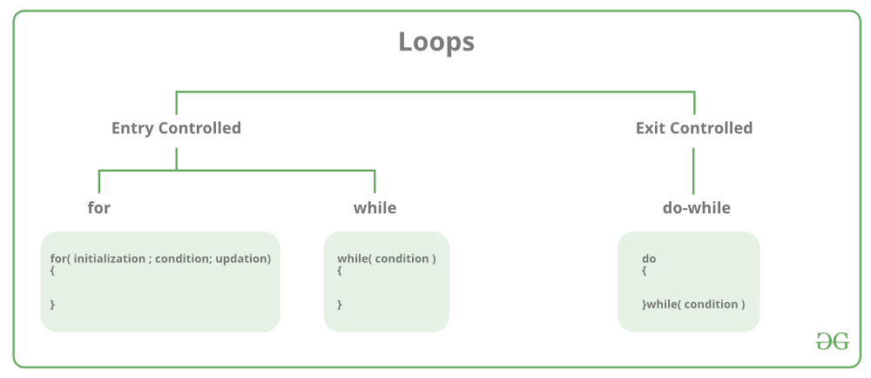
Control Flow / Looping statements

Slide 80
for loop
It is called as entry controlled loop.
A For loop is a repetition control structure that allows us to write a loop that is executed a specific number of times. The loop enables us to perform n number of steps together in one line.
for loop contains 3 parts.
Initialization
Condition
Iteration
Syntax:
for ( initial value; condition; increment/decrement )
{
statement(s);
}

Slide 81
for loop – Example
#include <iostream>
using namespace std;
int main ()
{
// for loop execution
for( int a = 10; a<20; a++)
{
cout << "value of a: " << a << endl;
}
return 0;
}
Output:
value of a: 10
value of a: 11
value of a: 12
value of a: 13
value of a: 14
value of a: 15
value of a: 16
value of a: 17
value of a: 18
value of a: 19

Slide 82
While loop
In C++, while loop is used to iterate a part of the program several times.
while loops are used in situations where we do not know the exact number of iterations of the loop beforehand. The loop execution is terminated on the basis of the test conditions.
Syntax:
initialization;
while (test_condition)
{
// statements
update_expression;
}

Slide 83
While loop – Example
#include <iostream>
using namespace std;
int main()
{
int i = 1; // initialization
while (i < 6) // test condition
{
cout << "Hello World\n";
i++; // update expression
}
return 0;
}
Output:
Hello World
Hello World
Hello World
Hello World
Hello World

Slide 84
Do - While loop
In Do-while loops also the loop execution is terminated on the basis of test conditions.
The main difference between a do-while loop and the while loop is in the do-while loop the condition is tested at the end of the loop body, i.e do-while loop is exit controlled whereas the other two loops are entry-controlled loops.
In a do-while loop, the loop body will execute at least once irrespective of the test condition.

Slide 85
Do - While loop
Syntax:
initialization condition;
do
{
// statements
update_expression;
} while (test_condition);
Note: Notice the semi – colon(“;”)in the end of loop.

Slide 86
Do - While loop Example
#include <iostream>
using namespace std;
int main()
{
int i = 2; // Initialization condition
do {
// loop body
cout << "Hello World\n";
i++; // update expression
} while (i < 1); // test condition
return 0;
}
Output
Hello World

Slide 87
Jump statements in C++
Jump statements are used to manipulate the flow of the program if some conditions are met.
It is used to terminating or continues the loop inside a program or to stop the execution of a function.
In C++ there is four jump statements, They are
continue
break
return
goto

Slide 88
Jump statements in C++
Continue statement
It is used to execute other parts of the loop while skipping some parts declared inside the condition, rather than terminating the loop, it continues to execute the next iteration of the same loop.
It is used with a decision-making statement which must be present inside the loop.
This statement can be used inside for loop or while or do-while loop.
Syntax:
continue;

Slide 89
Jump statements in C++
#include <iostream>
using namespace std;
int main()
{
for (int i = 1; i < 10; i++)
{
if (i == 5)
continue;
cout << i << " ";
}
return 0;
}
Output:
1 2 3 4 6 7 8 9

Slide 90
Jump statements in C++
Break statement
It is used to terminate the whole loop if the condition is met. Unlike the continue statement after the condition is met, it breaks the loop and the remaining part of the loop is not executed.
Break statement is used with decision-making statements such as if, if-else, or switch statement which is inside the for loop which can be for loop, while loop, or do-while loop.
It forces the loop to stop the execution of the further iteration.
Syntax:
break;

Slide 91
Jump statements in C++
#include <iostream>
using namespace std;
int main()
{
for (int i = 1; i < 10; i++)
{
if (i == 5) // Breaking Condition
break;
cout << i << " ";
}
return 0;
}
Output:
1 2 3 4

Slide 92
Jump statements in C++
return statement
It takes control out of the function itself. It is stronger than a break.
It is used to terminate the entire function after the execution of the function or after some condition.
Every function has a return statement with some returning value except the void() function.
Although void() function can also have the return statement to end the execution of the function.
Syntax:
return expression;

Slide 93
Jump statements in C++
#include <iostream>
using namespace std;
int main()
{
cout << "Begin ";
for (int i = 0; i < 10; i++)
{
if (i == 5)
return 0;
cout << i << " ";
}
cout << "end";
return 0;
}
Output:
Begin 0 1 2 3 4

Slide 94
Jump statements in C++
Goto Statement
This statement is used to jump directly to that part of the program to which it is being called.
Every goto statement is associated with the label which takes them to part of the program for which they are called.
The label statements can be written anywhere in the program it is not necessary to use before or after goto statement.

Slide 95
Jump statements in C++
Syntax:
goto label_name;
.
.
.
label_name:

Slide 96
Jump statements in C++
#include <iostream>
using namespace std;
int main()
{
int n = 4;
if (n % 2 == 0)
goto label1;
else
goto label2;
label1:
cout << "Even" << endl;
return 0;
label2:
cout << "Odd" << endl;
}
Output:
Even

Slide 97
Type conversion
When the expression has data of mixed data types at that time, type conversion is necessary.
The data type is promoted from lower to higher because converting higher to lower involves loss of precision and value
C++ allows us to convert data of one type to that of another. This is known as type conversion.
There are two types of type conversion in C++.
Implicit Conversion
Explicit Conversion (Type Casting)

Slide 98
Type conversion
Implicit Type Conversion
The type conversion that is done automatically done by the compiler is known as implicit type conversion. This type of conversion is also known as automatic conversion.
Done by the compiler on its own, without any external trigger from the user.
Generally takes place when in an expression more than one data type is present. In such condition type conversion (type promotion) takes place to avoid lose of data.

Slide 99
Type conversion
All the data types of the variables are upgraded to the data type of the variable with largest data type.
bool -> char -> short int -> int ->
unsigned int -> long -> unsigned ->
long long -> float -> double -> long double

Slide 100
Type conversion
#include <iostream>
using namespace std;
int main()
{
int x = 10; // integer x
char y = 'a'; // character c
// y implicitly converted to int. ASCII value of 'a' is 97
x = x + y;
// x is implicitly converted to float
float z = x + 1.0;
cout << "x = " << x << endl
<< "y = " << y << endl
<< "z = " << z << endl;
return 0;
}
Output:
x = 107
y = a
z = 108

Slide 101
Type conversion
Explicit type conversions can be forced in any expression to change the type by programmer.
This process is also called type casting and it is user-defined. Here the user can typecast the result to make it of a particular data type.
In C++, it can be done by two ways:
Syntax:
(type-name) expression; OR type-name (expression);

Slide 102
Type conversion
Example 1
Example 2
#include <iostream>
using namespace std;
int main()
{
short a;
float c=4264.56789;
a=(short)c;
cout<<a; // value of a = 4264
}
#include <iostream>
using namespace std;
int main()
{
int a=5,b=2, c=6;
float d;
d= float (a+b+c) / 3;
cout<<d; // value of d = 4.33333
}

Slide 103
Manipulators in C++
Manipulators are helping functions that can modify the input/output stream.
It does not mean that we change the value of a variable, it only modifies the I/O stream using insertion (<<) and extraction (>>) operators.
Manipulators are special functions that can be included in the I/O statement to alter the format parameters of a stream.
Manipulators are operators that are used to format the data display.
To access manipulators, the file iomanip.h should be included in the program.

Slide 104
Manipulators in C++
Manipulator Meaning
endl - This manipulator has the same functionality as ‘\n’(newline character).
setw (int n) - To set field width to n setprecision (int p) - The precision is fixed to p setfill (Char f) - To set the character to be filled Setbase(int b) - To set the base of the number to b

Slide 105
Manipulators in C++
endl function is used to insert a new line character and flush the stream.
Working of endl manipulator is similar to '\n' character in C++. It prints the output of the following statement in the next line.
Example:
#include<iostream>
using namespace std;
int main()
{
cout << "Hello" << endl << "World!";
}

Slide 106
Manipulators in C++
setw ()
The setw() function is an output manipulator that inserts whitespace between two variables. You must enter an integer value equal to the needed space. Syntax: setw ( int n) Example: int a=15; int b=20; cout << setw(10) << a << setw(10) << b << endl;

Slide 107
Manipulators in C++
setfill()
It replaces setw(whitespaces )’s with a different character. It’s similar to setw() in that it manipulates output, but the only parameter required is a single character.
Syntax: setfill(char ch) Example: int a,b; a=15; b=20; cout<< setfill(‘*’) << endl;
cout << setw(5) << a << setw(5) << a << endl;

Slide 108
Manipulators in C++
setfill() Example: #include <iostream>
#include <iomanip>
int main() {
int a, b;
a = 15;
b = 20;
std::cout << std::setfill('*') << std::endl;
std::cout << std::setw(5) << a << std::setw(5) << b << std::endl;
return 0;
} // Output: ***15***20

Slide 109
Manipulators in C++
setprecision
It is an output manipulator that controls the number of digits to display after the decimal for a floating point integer.
Syntax: setprecision (int p) Example:
float A = 1.34255;
cout <<fixed<< setprecision(3) << A << endl; // Output: 1.342

Slide 110
Manipulators in C++
setbase()
The setbase() manipulator is used to change the base of a number to a different value.
The following base values are supported by the C++ language. hex (Hexadecimal = 16) oct (Octal = 8) dec (Decimal = 10)

Slide 111
Manipulators in C++
Output
Hex Value = 64
Octal Value= 144
Setbase Value= 144
Setbase Value= 64
setbase() – Example
#include <iostream>
#include <iomanip>
using namespace std;
main()
{
int number = 100;
cout << "Hex Value =" << " " << hex << number << endl;
cout << "Octal Value=" << " " << oct << number << endl;
cout << "Setbase Value=" << " " << setbase(8) << number << endl;
cout << "Setbase Value=" << " " << setbase(16) << number << endl;
return 0;
}

Slide 112
Thank you!!!

